Slide 1
3D Brain-TAMP Development of 3D Brain through Taxonomy, Anatomy, Morphology, and Physiology

Slide 2
Our Team
Team Members:
Mohammad Hasnain
Sajjad Ali
Mujeeb Ahmed
Supervised by:
Dr. Ahsanullah Abro

Slide 3
Agenda
Overall System Description
Functional Requirements
Use Cases
Non Functional Requirements
Entity Relationship Diagram (ERD)
Sequence Diagrams
Architecture Design Diagram
Database Diagram
Class Diagram
Interface Design
Test Cases

Slide 4
Overall System Description
Project Background
The 3D android application for the human brain is a tutorial app that provides a unique and interactive way of learning about the human brain.
Project Objectives
To design and develop an interactive User Interface to learn about the human brain using 3D models.
To offer to learn to users about the human brain and its different parts of the human brain and how they work.
To provide an engaging learning user experience to understand the human brain for students, educators, and even anyone who is of his/hers interest.

Slide 5
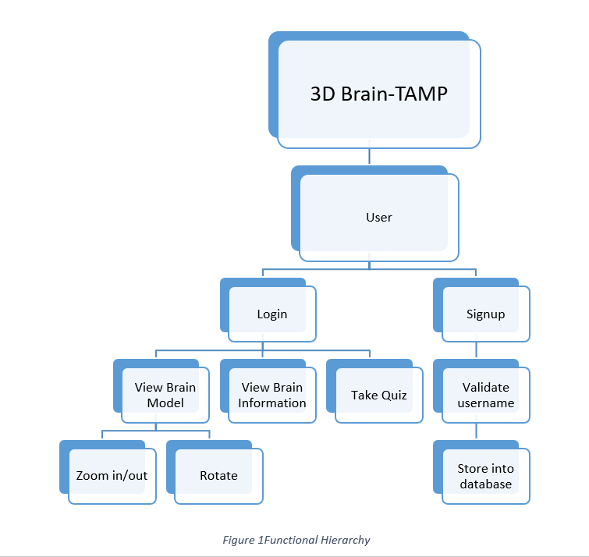
Functional Requirements
Functional Hierarchy
The functional hierarchy of the 3D android application for the human brain can be divided into the following modules:

Slide 6
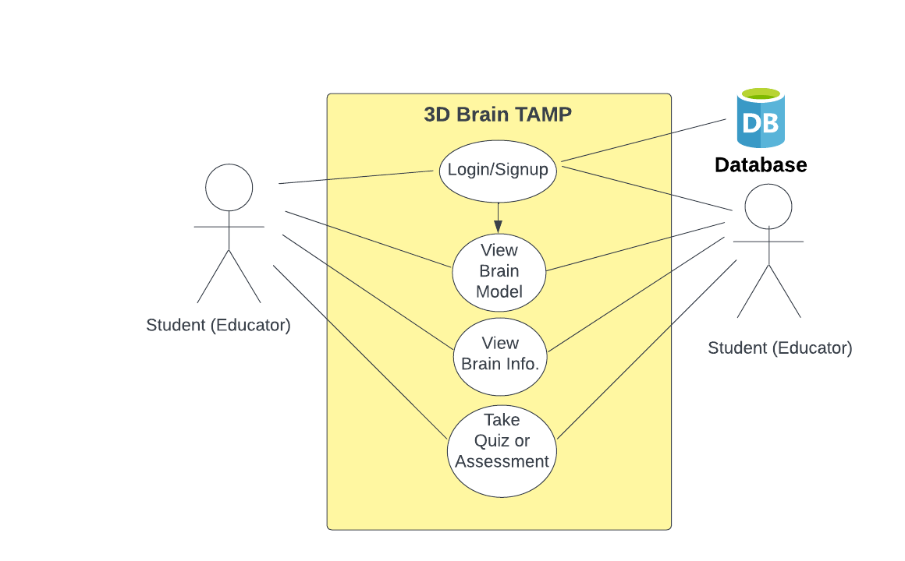
Use Cases

Slide 7
Non-Functional Requirements
Performance Requirements
The application should run smoothly on Android devices with minimum system requirements and not have any lag or delay in loading the 3D models and information.
Reliability Requirements
The application should be reliable and have minimal downtime. The application should not crash or have any unexpected errors.
Security Requirements
The application should be secure from any unauthorized access or data theft. The personal information of the users should be protected and not shared with any third parties.
User Documentation

Slide 8
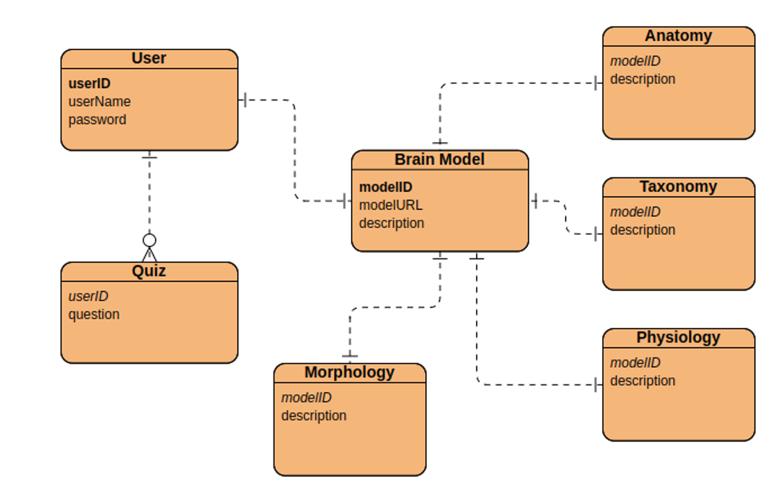
Entity Relationship Diagram (ERD)

Slide 9
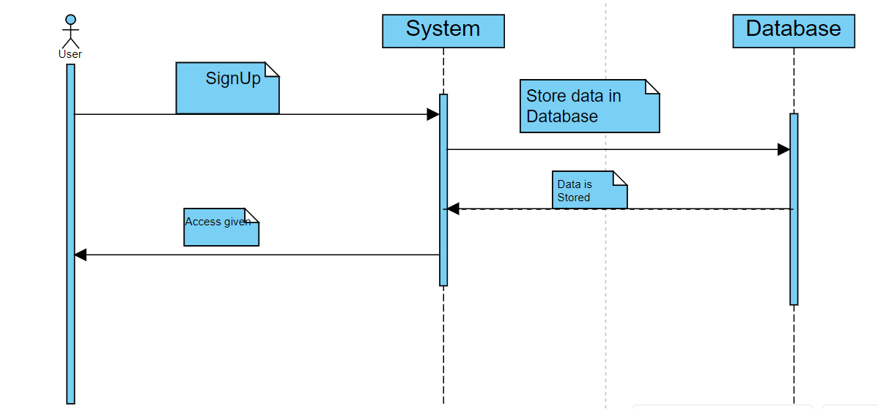
Sequence Diagrams
Sign up:

Slide 10
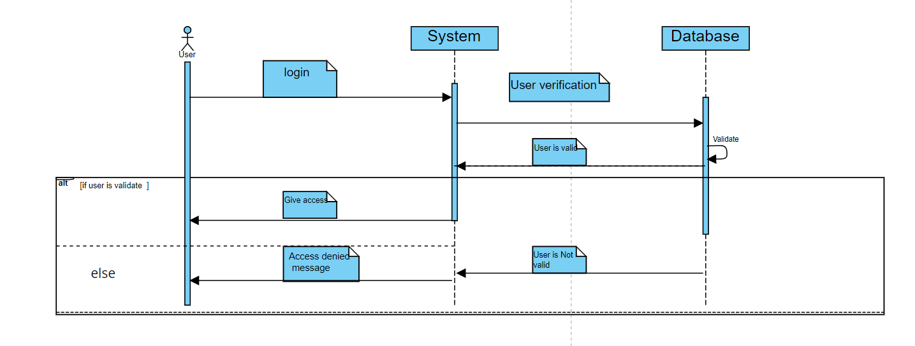
Sequence Diagrams
Login

Slide 11
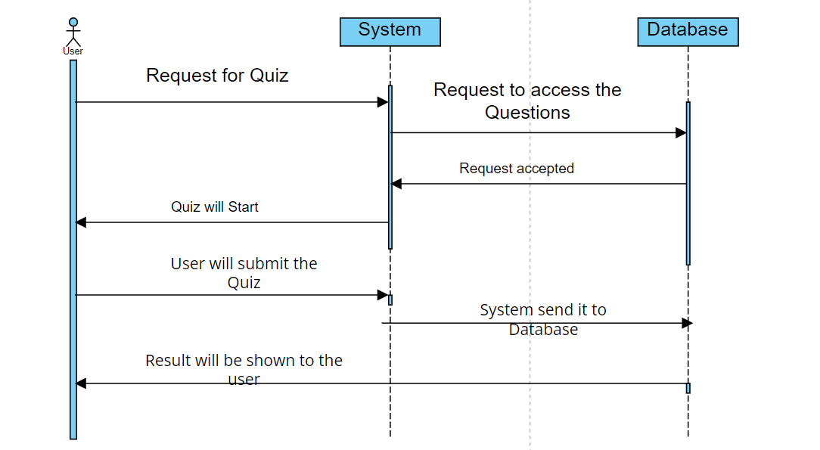
Sequence Diagrams
Take Quiz/Assessment

Slide 12
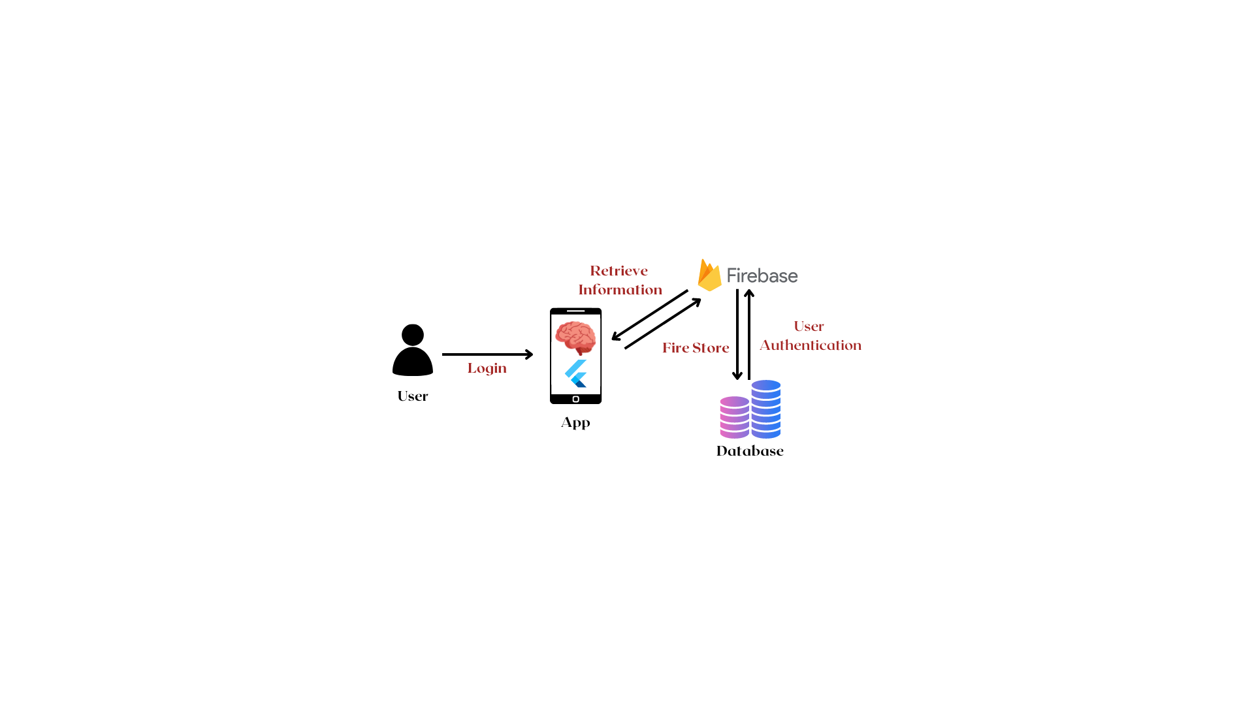
Architecture Design Diagram

Slide 13
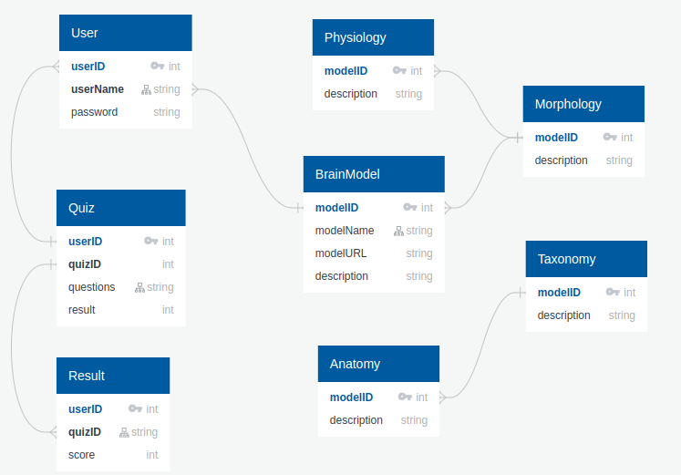
Database Diagram

Slide 14
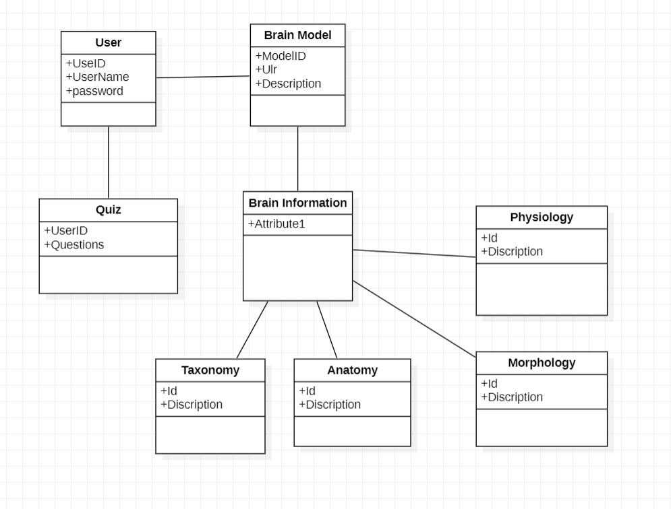
Class Diagram

Slide 15
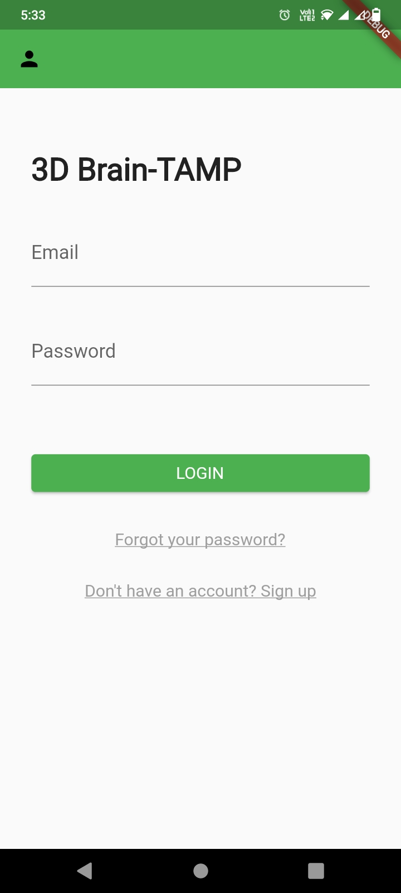
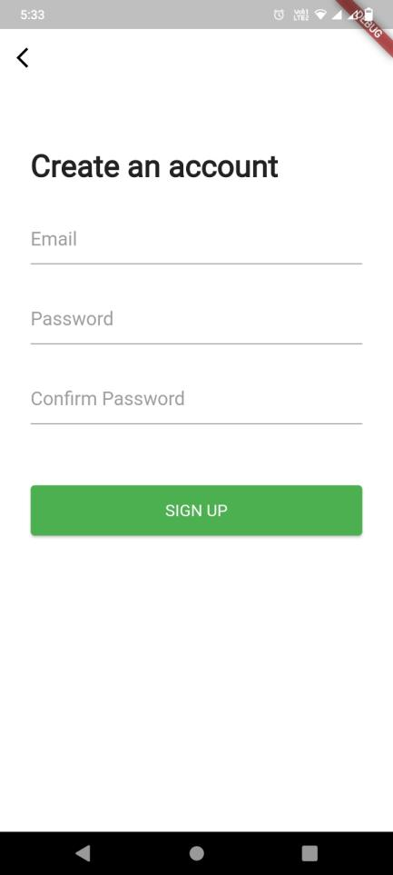
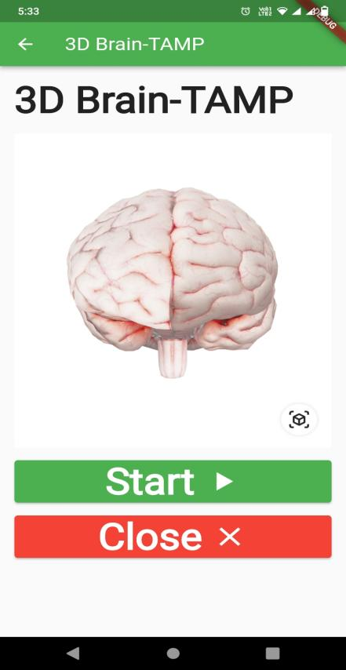
Interface Design

Slide 16
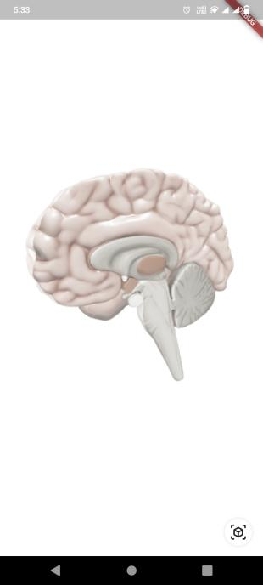
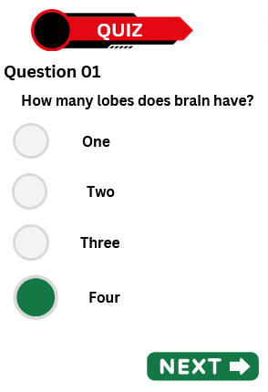
Interface Design

Slide 17
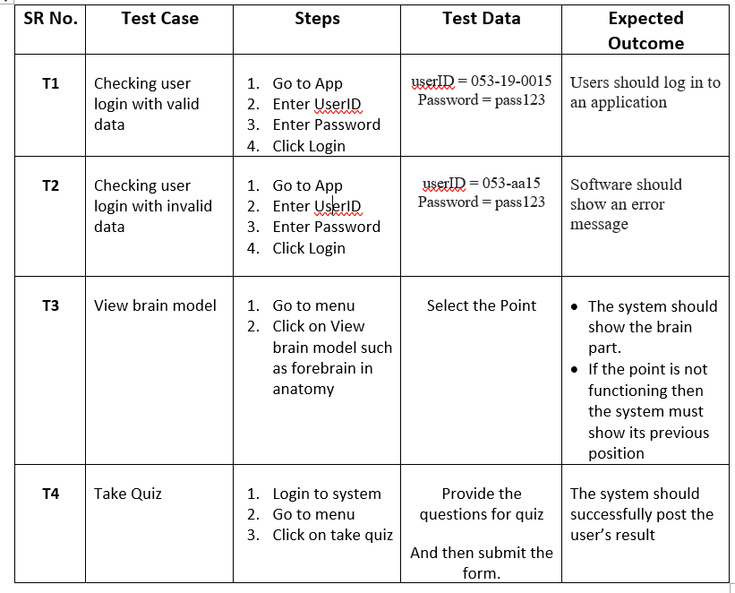
Test Cases

Slide 18
Thank you!

